Slide 1

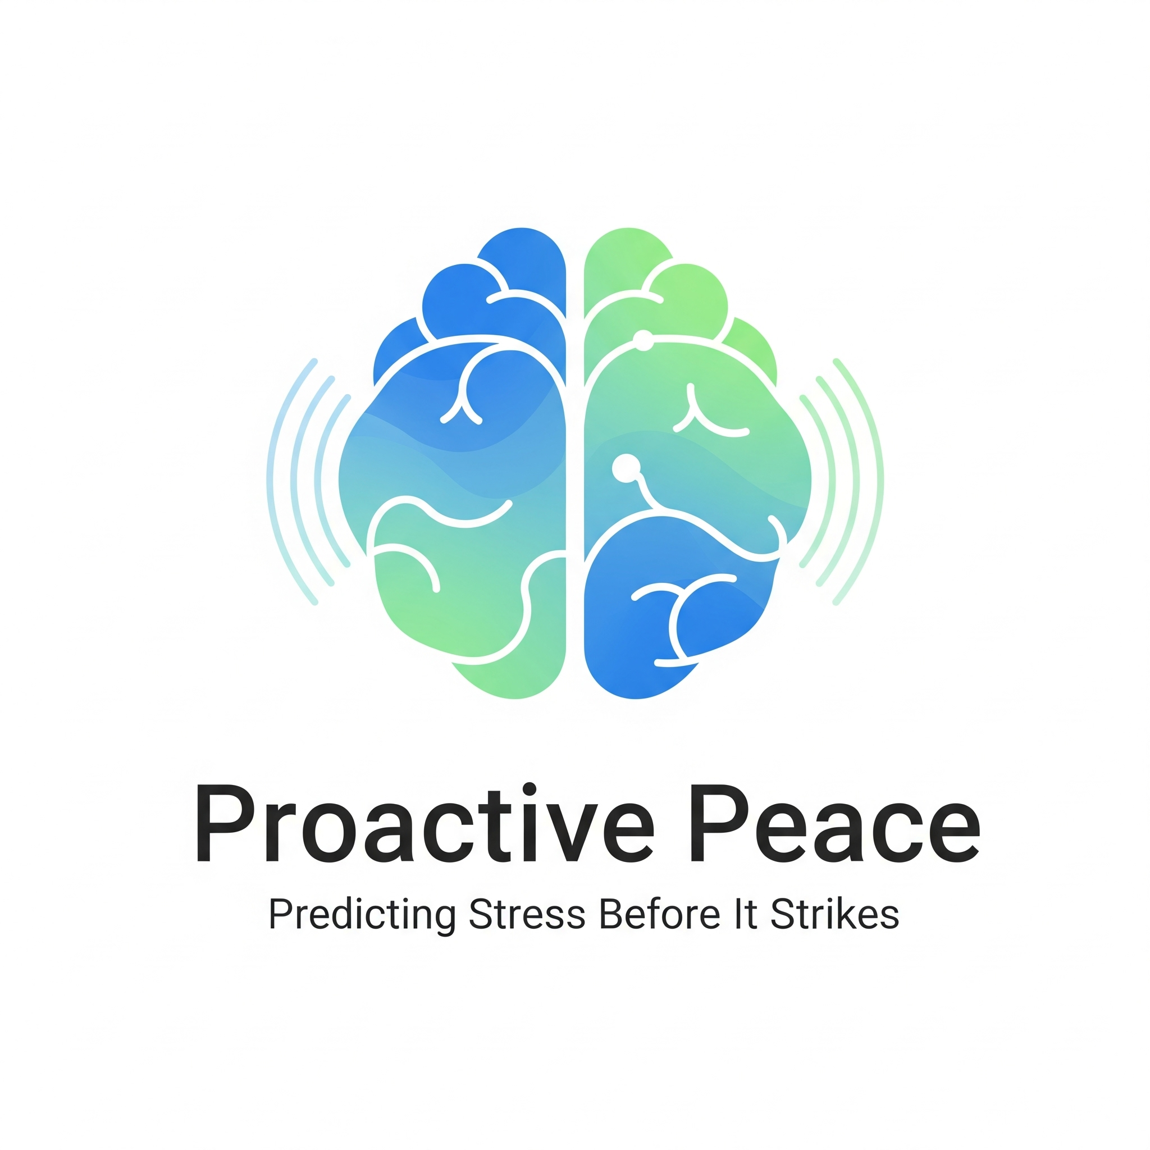
Proactive Peace
Predicting Stress Before It Strikes
Nancy Goyal
June, 2025
Notes:
HR Managers in critical industries, Health & Safety Professionals, Tech

Slide 2
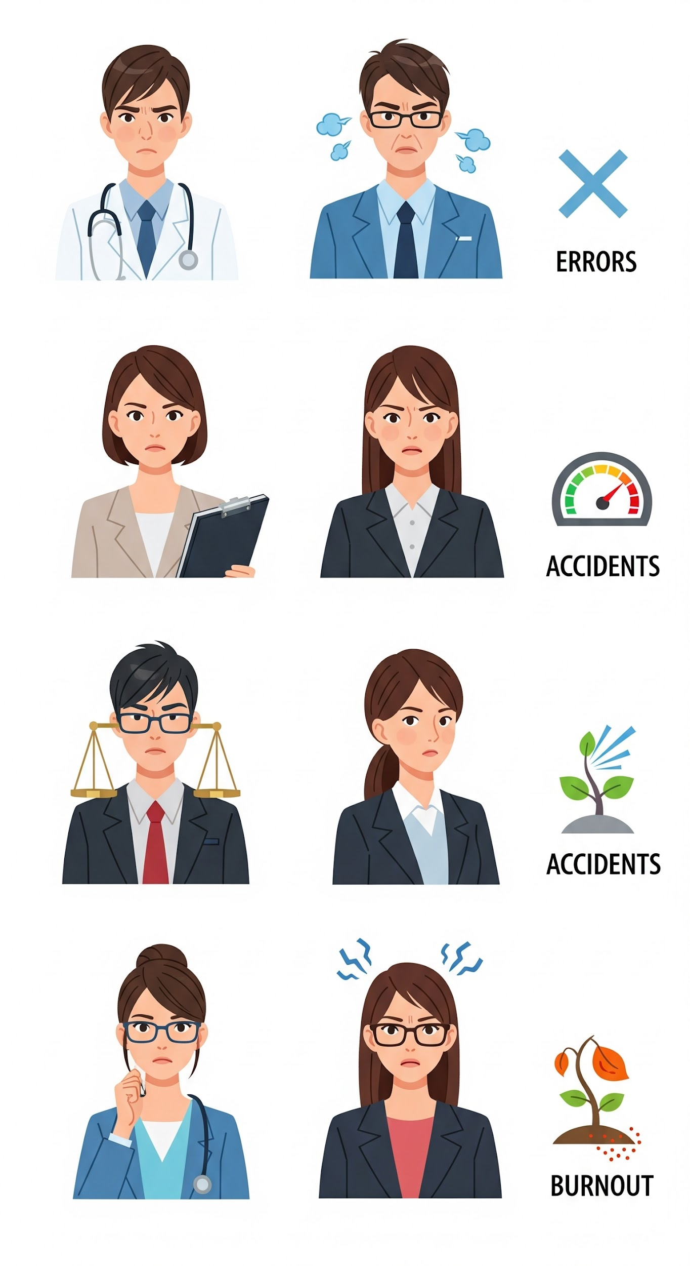
Unseen Burden: A Silent Epidemic
Stress isn't just a buzzword, especially in critical jobs
Current Reality - Reactive solutions
Critical Gap - ability to anticipate
What if you could see it coming?
Notes:
Every day, millions of dedicated professionals – our nurses, our teachers, our drivers – shoulder immense responsibility. They make critical decisions, often under extreme pressure. But what happens when that pressure reaches its breaking point?
We see the signs when they're already advanced, often after the damage is done. We offer reactive solutions: counseling, time off – all important, but often too late for prevention.
What's missing is the ability to anticipate. To predict the probability of someone reaching that stress threshold before they're overwhelmed. This is where we come in.

Slide 3

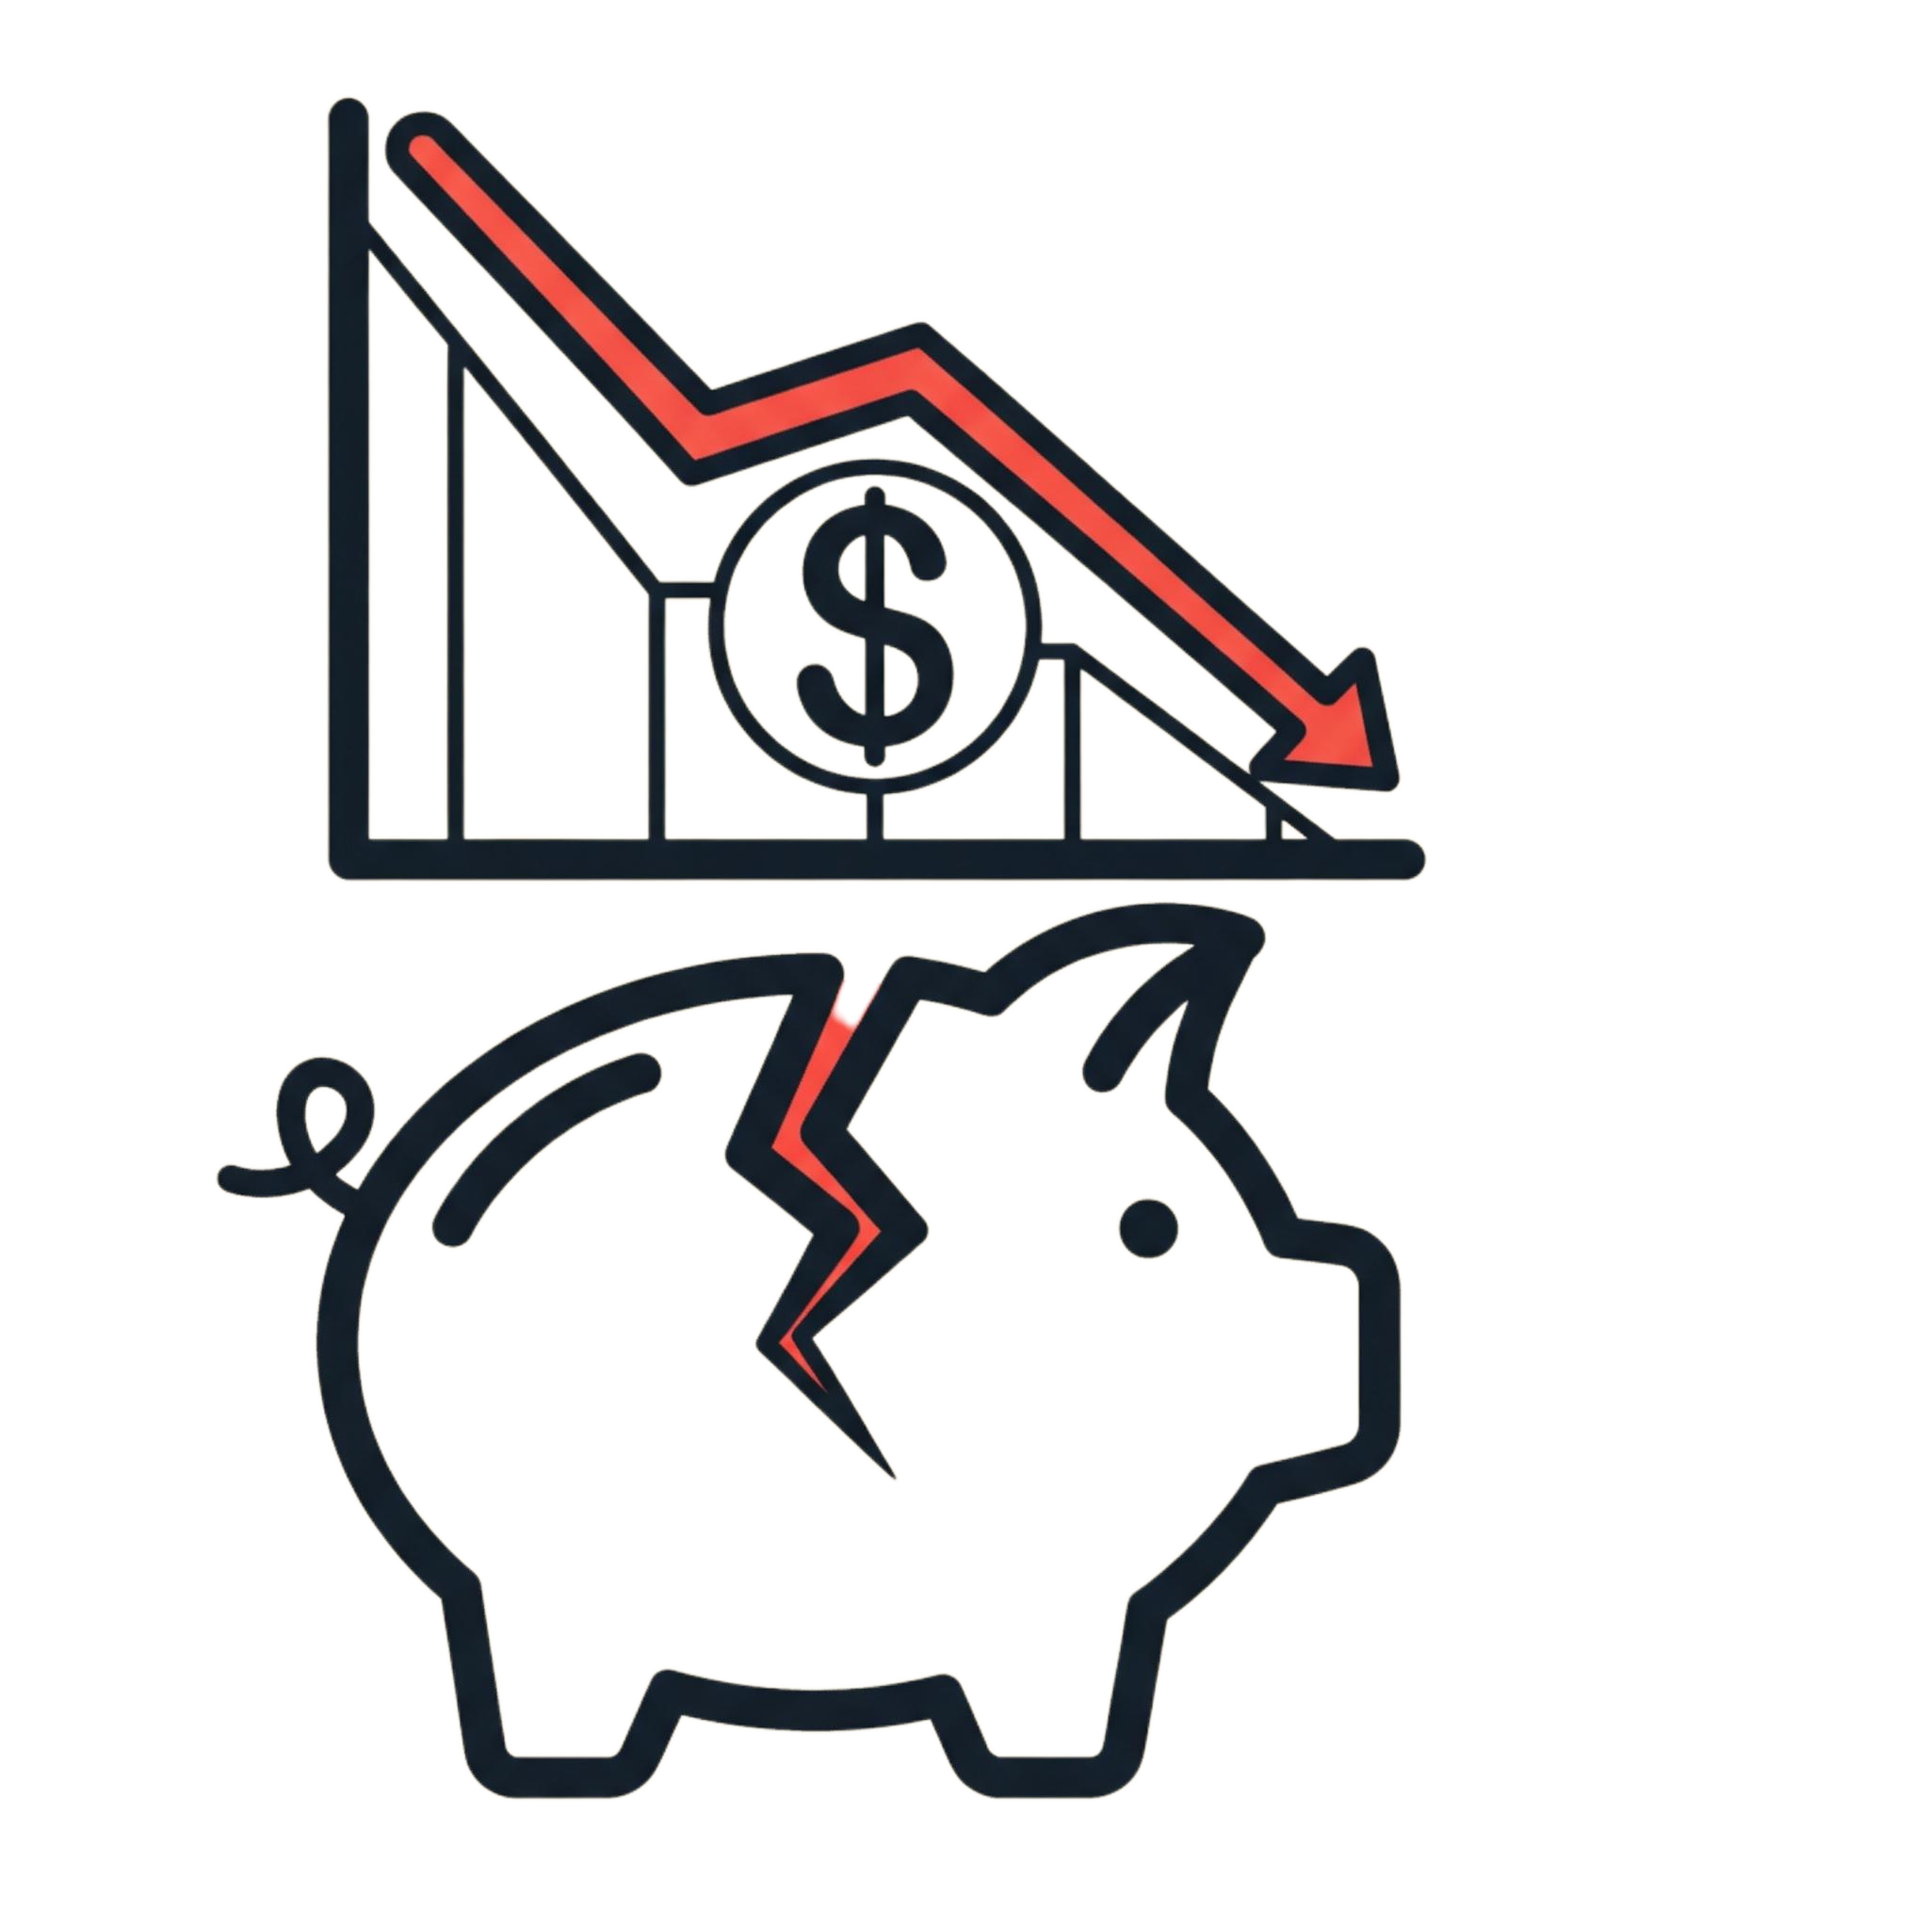
What is the issue?
Why is it important to solve it?
Which Industry will benefit?
Healthcare is Reactive
The Cost is unsustainable
The Healthcare Ecosystem
We treat diseases after they happen.
Lack of Foresight - Individuals have no clear understanding of their future health risks
Patient context is used to react, not to predict
"What If?" Questions Go Unanswered
Skyrocketing costs for patients & providers
Poor patient outcomes for chronic diseases
Episodic Care: Risks missing critical health signals due to infrequent monitoring.
Mental burden of health uncertainty.
Healthcare Providers & Payers: Shift from costly treatments to preventative care.
Studies & Research: Develop more effective, targeted therapies.
Individuals & Employers: Foster healthier lives and more productive workforces.
Notes:
Every day, millions of dedicated professionals – our nurses, our teachers, our drivers – shoulder immense responsibility. They make critical decisions, often under extreme pressure. But what happens when that pressure reaches its breaking point?
We see the signs when they're already advanced, often after the damage is done. We offer reactive solutions: counseling, time off – all important, but often too late for prevention.
What's missing is the ability to anticipate. To predict the probability of someone reaching that stress threshold before they're overwhelmed. This is where we come in.

Slide 4
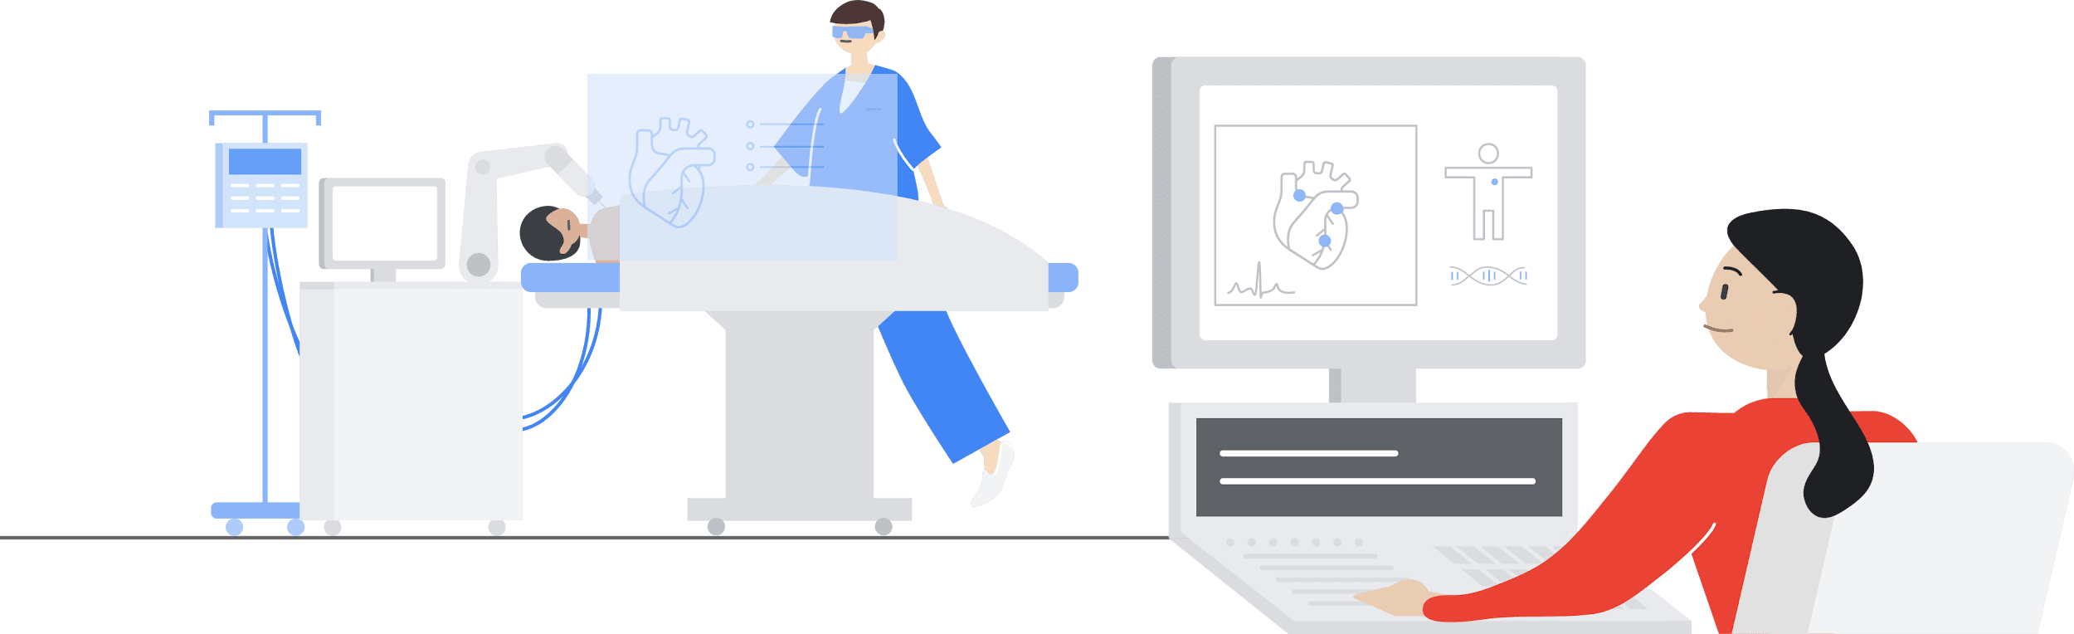


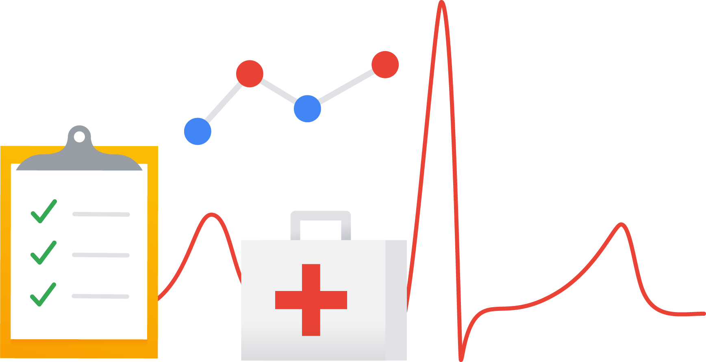


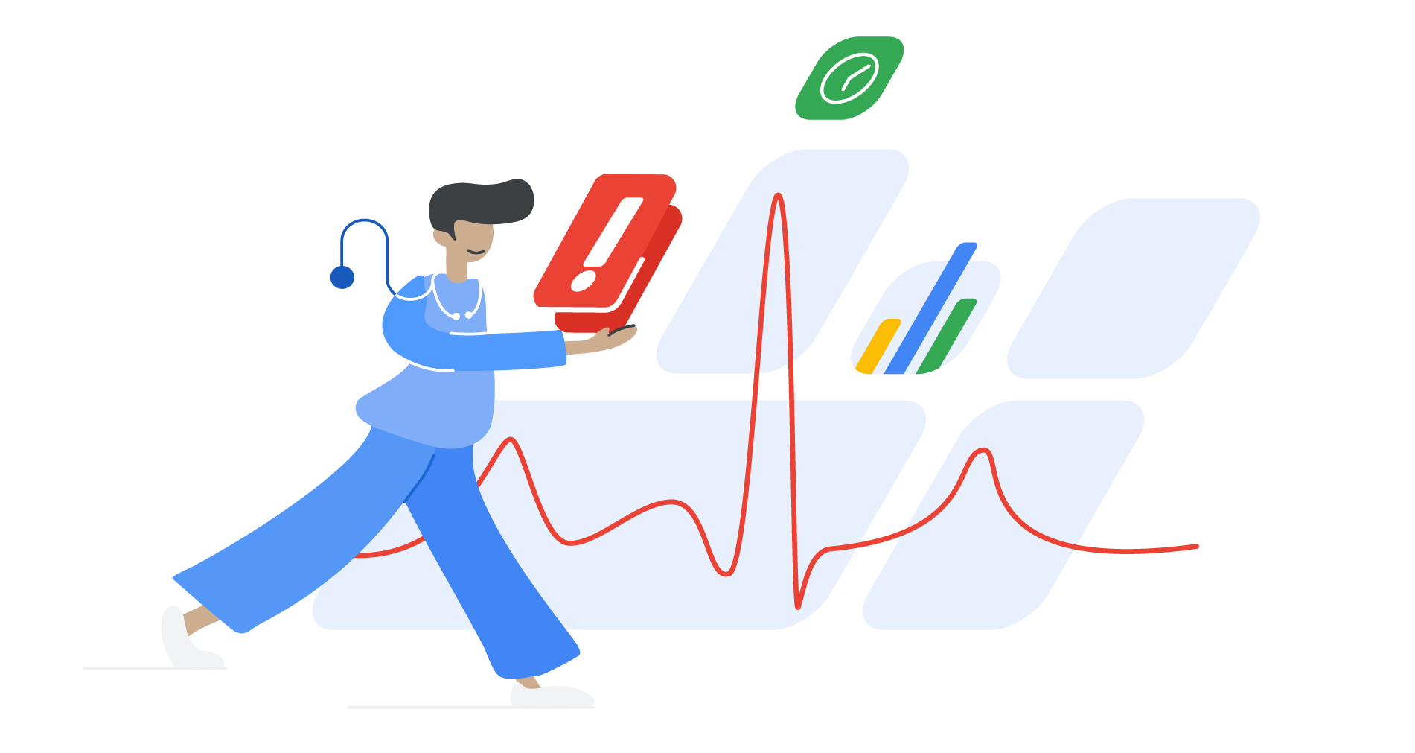

The Anxious, Reactive Health Journey
Hi, how can I help?
Jiga supports old house in a rural area and is having some symptoms like fatigue, mood swings, blurred vision. She is concerned about what to do next
She goes to her Doctor and explain the symptoms.
The Doctor requests previous health records, stress test reports and the current vitals
Patient understands her condition based on the information obtained by trained doctors, takes sick days and changes lifestyle required for improvement of the condition.
Doctor explains the treatment, prescribes medicines with follow up schedules

Slide 5
and answer is Proactive Peace
Probability Score Dashboard
Personalized Insights
Proactive Nudges/Recommendations
Notes:
Every day, millions of dedicated professionals – our nurses, our teachers, our drivers – shoulder immense responsibility. They make critical decisions, often under extreme pressure. But what happens when that pressure reaches its breaking point?
We see the signs when they're already advanced, often after the damage is done. We offer reactive solutions: counseling, time off – all important, but often too late for prevention.
What's missing is the ability to anticipate. To predict the probability of someone reaching that stress threshold before they're overwhelmed. This is where we come in.

Slide 6

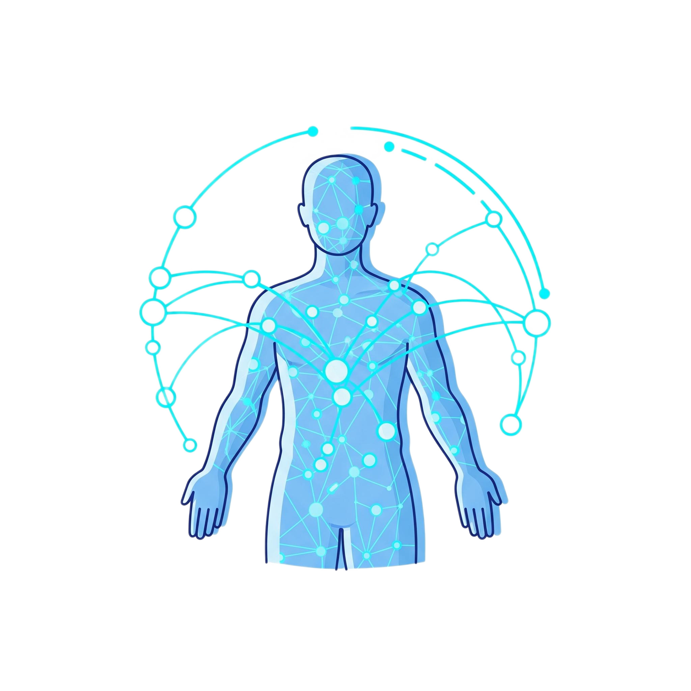
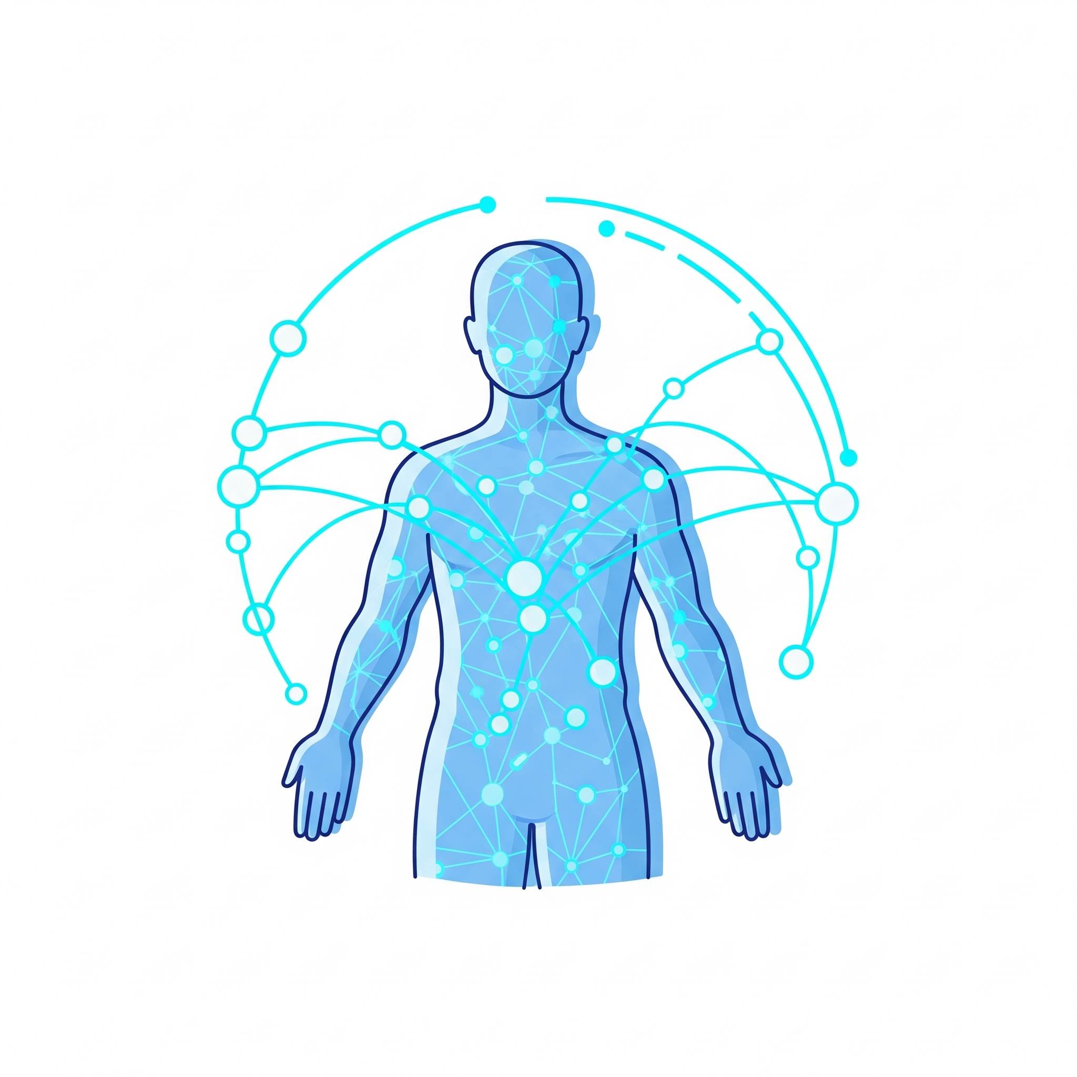
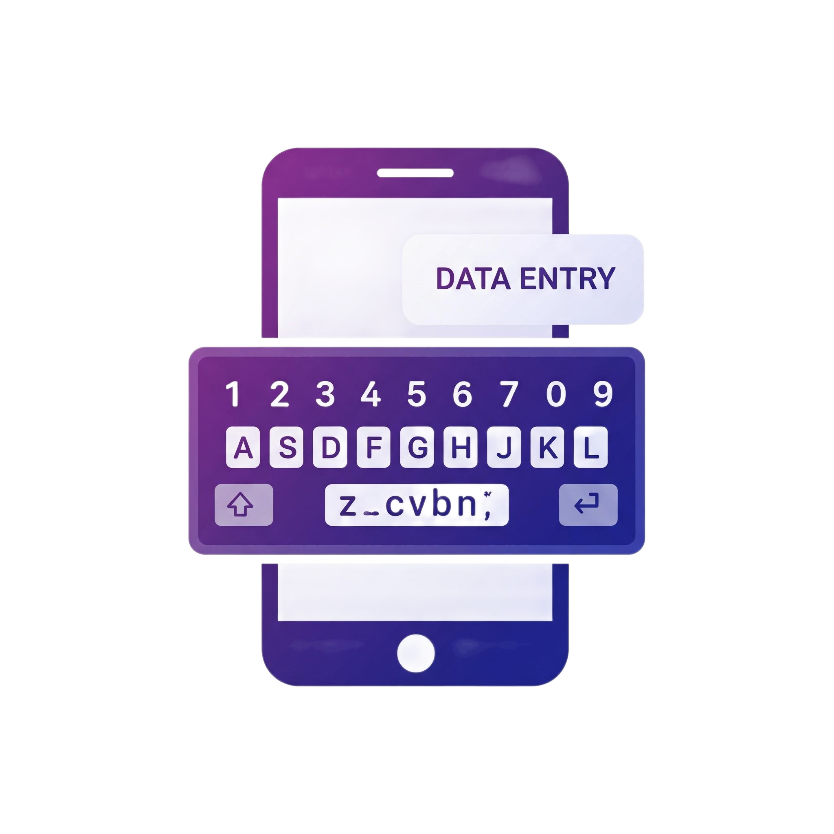
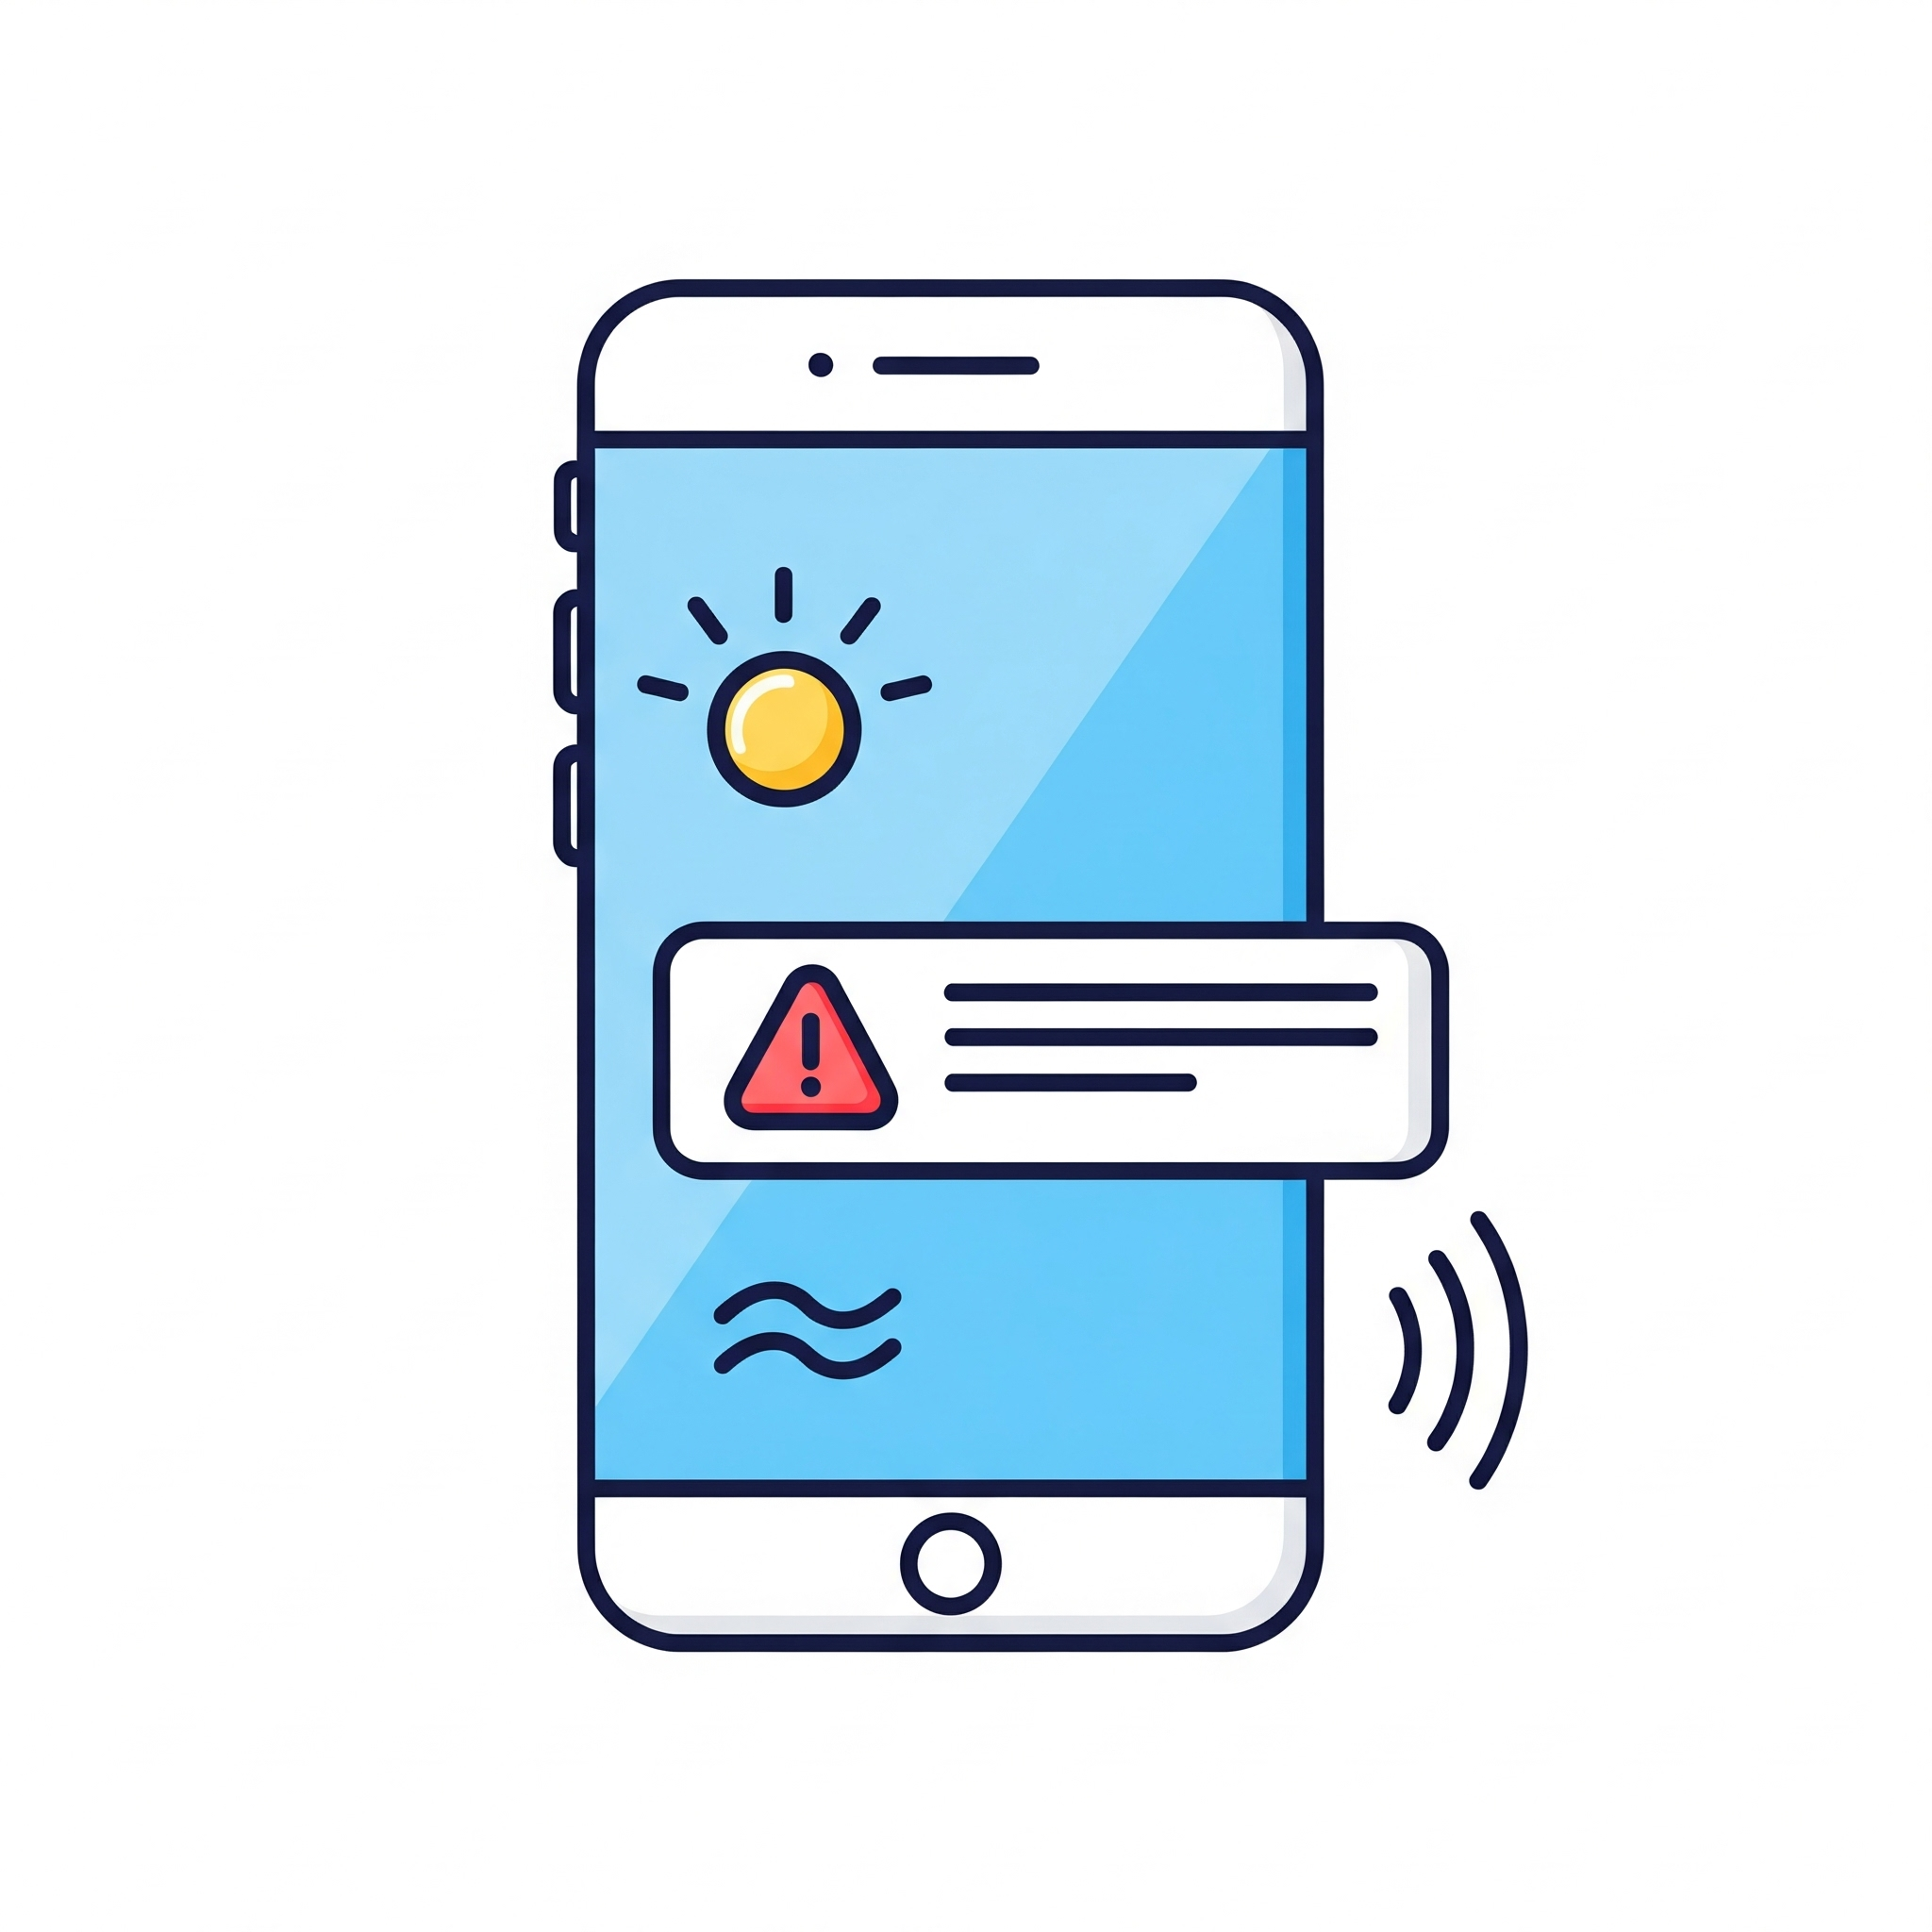
The Peaceful, Proactive Health Journey
History
Collecting Patient EMR
Build Current Habits
Collect answers for standard Questionnaire
Real Time Health Monitoring
Get wearables data
Building Patient Profile
Data Driven Scan
Proactive Monitoring
Jiga is living her life, feeling perfectly normal
Proactive peace showing report with her self-reported vitals and elevated heart rate recently.
Alert and Action
Clara’s Boss opens the app. He sees a simple visual showing her risk trajectory has increased. The app doesn’t just present a problem; it offers a solution. It provides a clear, one-page summary of the key contributing factors and suggests, "It might be a good time for a preventative action and a short meditation pause"
She goes to her Doctor much earlier with more context for preventive treatment

Slide 7
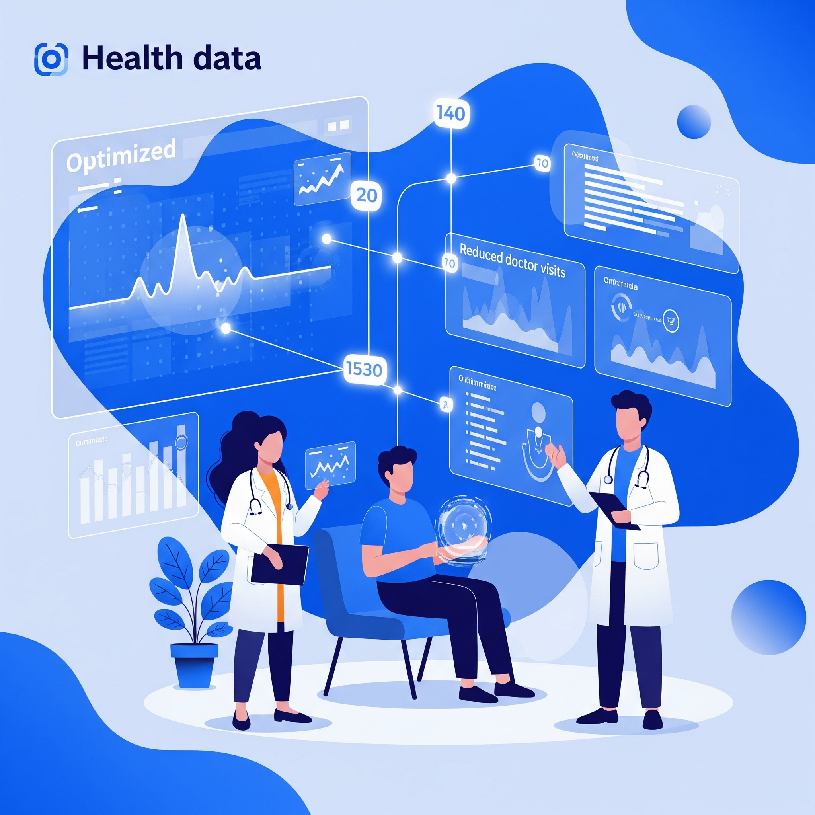
Quantified Health Impact
Clinical expenses and sick days reduced by XX%.
Lower readmission rates for chronic disease seen.
Insurance claim for errors reduced by XX% per patient.
Accidents reduced by XX% by drivers.
Notes:
Every day, millions of dedicated professionals – our nurses, our teachers, our drivers – shoulder immense responsibility. They make critical decisions, often under extreme pressure. But what happens when that pressure reaches its breaking point?
We see the signs when they're already advanced, often after the damage is done. We offer reactive solutions: counseling, time off – all important, but often too late for prevention.
What's missing is the ability to anticipate. To predict the probability of someone reaching that stress threshold before they're overwhelmed. This is where we come in.

Slide 8

So What?
Reduced Burnout & Turnover
Increased Safety & Performance
Optimized Resource Allocation
Commitment to People Care

Slide 9
Let’s take a look at the solution

Slide 10
High level Solution
Raw Sensor Data Collection
Data Ingestion & Preprocessing
Resampling/Upsampling
Normalization
Feature Engineering & Windowing
Frequency-domain features
Physiological-specific metrics
Processed Feature Data
Machine Learning Model (XGBoost/LightGBM/CNN)
Prediction Engine
App Backend to capture readings in real time (FW*)
User Application (FW*)
Proactive Interventions & Recommendations (FW*)
Notes:
Raw Sensor Data Collection:
Source: Wearable devices (smartwatches, fitness trackers, chest straps) continuously collect physiological data like Heart Rate (HR), Blood Volume Pulse (BVP), Electrodermal Activity (EDA), Skin Temperature (TEMP), and Accelerometer (ACC) data.
Journey: Data is streamed wirelessly (e.g., Bluetooth) from the wearable to a connected smartphone or directly to a cloud endpoint.
Data Ingestion & Preprocessing:
Step: Raw, noisy sensor signals are ingested into the system. This involves:
Synchronization: Aligning data streams from different sensors if needed.
Resampling/Upsampling: Standardizing sampling rates across different modalities (e.g., upsampling EDA and ACC to match BVP).
Noise Reduction: Applying filters to remove artifacts (e.g., band-pass for ECG/BVP, low-pass for EDA).
Normalization: Scaling sensor data to a common range (e.g., 0-1).
Journey: Data moves from raw streams into temporary processing buffers or local storage on the device.
Feature Engineering & Windowing:
Step: Processed signals are segmented into fixed-length, overlapping windows (e.g., 60-second windows with 15-second subwindows).
Step: Discriminative features are extracted from each window, including:
Time-domain statistics: Mean, standard deviation, min/max, skewness, kurtosis.
Frequency-domain features: Using Fast Fourier Transform (FFT) to analyze spectral components (e.g., for BVP, EDA, ACC).
Physiological-specific metrics: Heart Rate Variability (HRV) from BVP, Skin Conductance Responses (SCRs) from EDA.
Journey: Segmented raw data transforms into a tabular format where each row represents a window's features, moving towards a structured database or in-memory feature store.
Processed Feature Data Storage:
Step: The extracted features for each window are stored, often in a time-series database or a structured cloud storage solution. This data is critical for model retraining and historical analysis.
Journey: From in-memory processing, data persists to durable storage (e.g., cloud database, local device database).
Machine Learning Model (Trained XGBoost/LightGBM):
Step: A pre-trained classification model (e.g., LightGBM or XGBoost) is loaded. This model has learned patterns from historical, labeled WESAD data to distinguish between "stress" and "non-stress" physiological states.
Journey: The trained model (saved as a .pkl or .joblib file) is loaded into the prediction environment (e.g., app backend, edge device runtime).
Prediction Engine:
Step: The loaded model receives the new, preprocessed feature data (one window at a time).
Step: It outputs a probability score indicating the likelihood of the current state being "stress" (e.g., 0.0 to 1.0).
Journey: Features are fed into the loaded ML model, and predictions/probabilities are generated.
App Backend / Cloud Services:
Step: The prediction results (probability of stress) are sent to a backend system.
Step: The backend can log predictions, apply business logic (e.g., trigger alerts based on thresholds), and integrate with other services (e.g., well-being platforms).
Journey: Prediction data moves from the prediction engine to a central server or cloud platform for further processing and persistent storage.
User Application (Mobile/Web):
Step: The user application receives the stress probability scores (and potentially historical trends).
Step: It visualizes the stress probability over time (e.g., a line graph) and provides real-time feedback or alerts.
Journey: Processed predictions are displayed to the end-user.
Proactive Interventions & Recommendations:
Step: Based on the predicted stress probability and configured thresholds, the app provides personalized, proactive recommendations (e.g., "Take a short break," "Practice mindful breathing," "Hydrate").
Journey: The user interacts with the app, leading to behavioral changes or engagement with well-being resources, completing a feedback loop for potential long-term stress management.

Slide 11
Data
The data has been recorded using two different devices (one chest-based and one wrist-based), each including high resolution physiological (BVP, ECG, EDA, EMG, RESP, and TEMP) and motion (ACC) modalities.
15 subjects had a mean age of 27.5 ± 2.4 years including male(12) and female(3)
36 minutes per subject. With 15 subjects and using a sliding window of 0.25 seconds, approximately 133000 windows were generated. 53 % belong to the baseline class, 30 % represent the stress class, and 17 % originate from the amusement condition
Notes:
Imagine a healthcare system where fewer errors occur due to stress. A transportation network with safer drivers. Classrooms where teachers are consistently at their best. Proactive peace makes this future a reality.

Slide 12
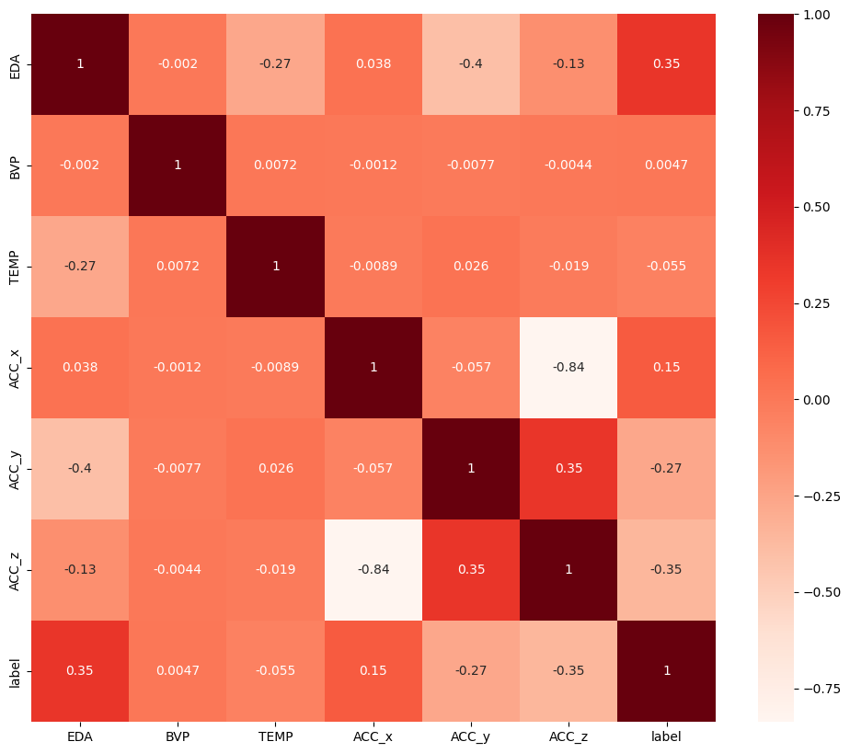
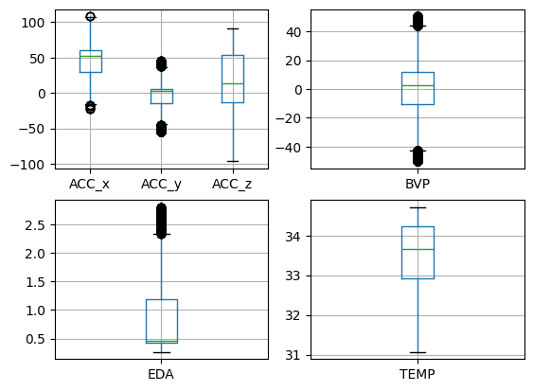
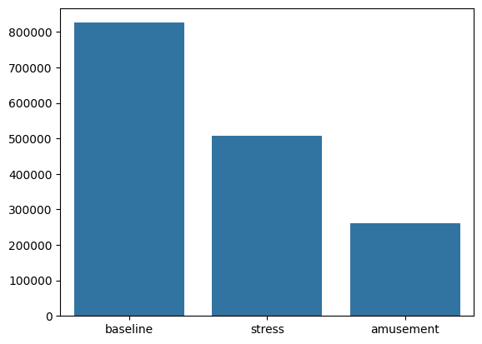
Example data
Electrodermal Activity (EDA) 3-axis accelerometer (ACC)
Blood Volume Pulse (BVP) skin Temperature (TEMP)
Notes:
Imagine a healthcare system where fewer errors occur due to stress. A transportation network with safer drivers. Classrooms where teachers are consistently at their best. Proactive peace makes this future a reality.

Slide 13
ML Models
CNN (Convolutional Neural Network): While capable of learning hierarchical features from time-series data, its implementation required precise handling of input tensor shapes and data types. (Specific average F1-score showed around 86.5%, high processing time)
XGBoost (Extreme Gradient Boosting):
Average F1-Score: 0.7601
Pros: Generally robust, good performance, handles class imbalance with scale_pos_weight.
Cons: Can be sensitive to hyperparameter tuning.
LightGBM (Light Gradient Boosting Machine):
Average F1-Score: 0.8151
Pros: Often faster than XGBoost, good performance, handles class imbalance with is_unbalance.
Cons: Similar to XGBoost, requires feature engineering.

Slide 14
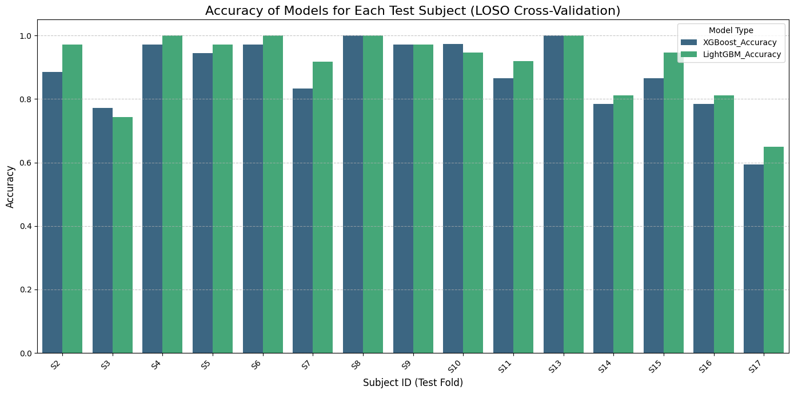
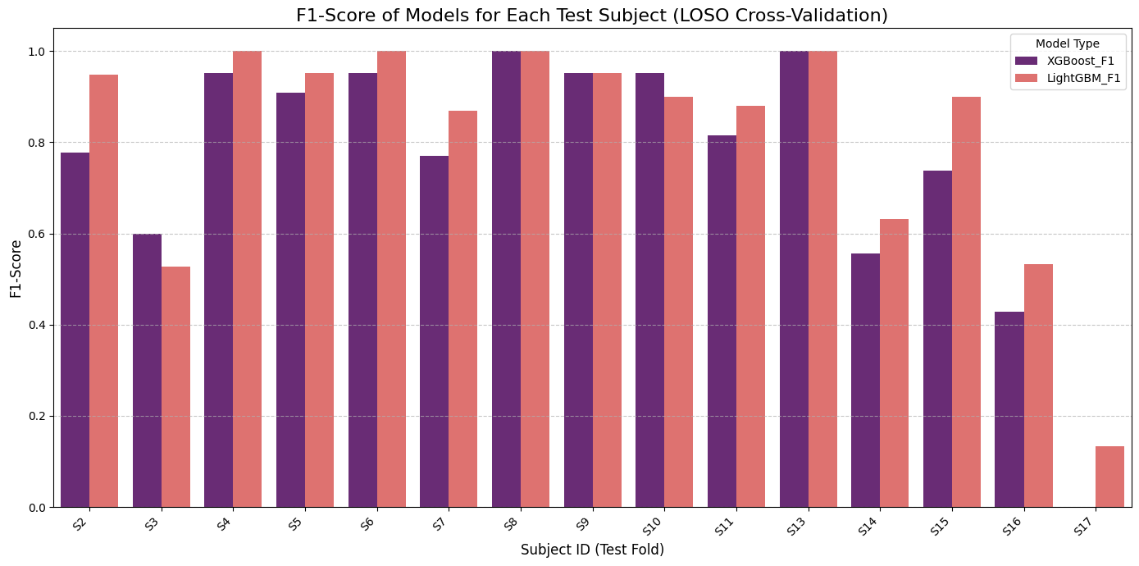
ML Models

Slide 15
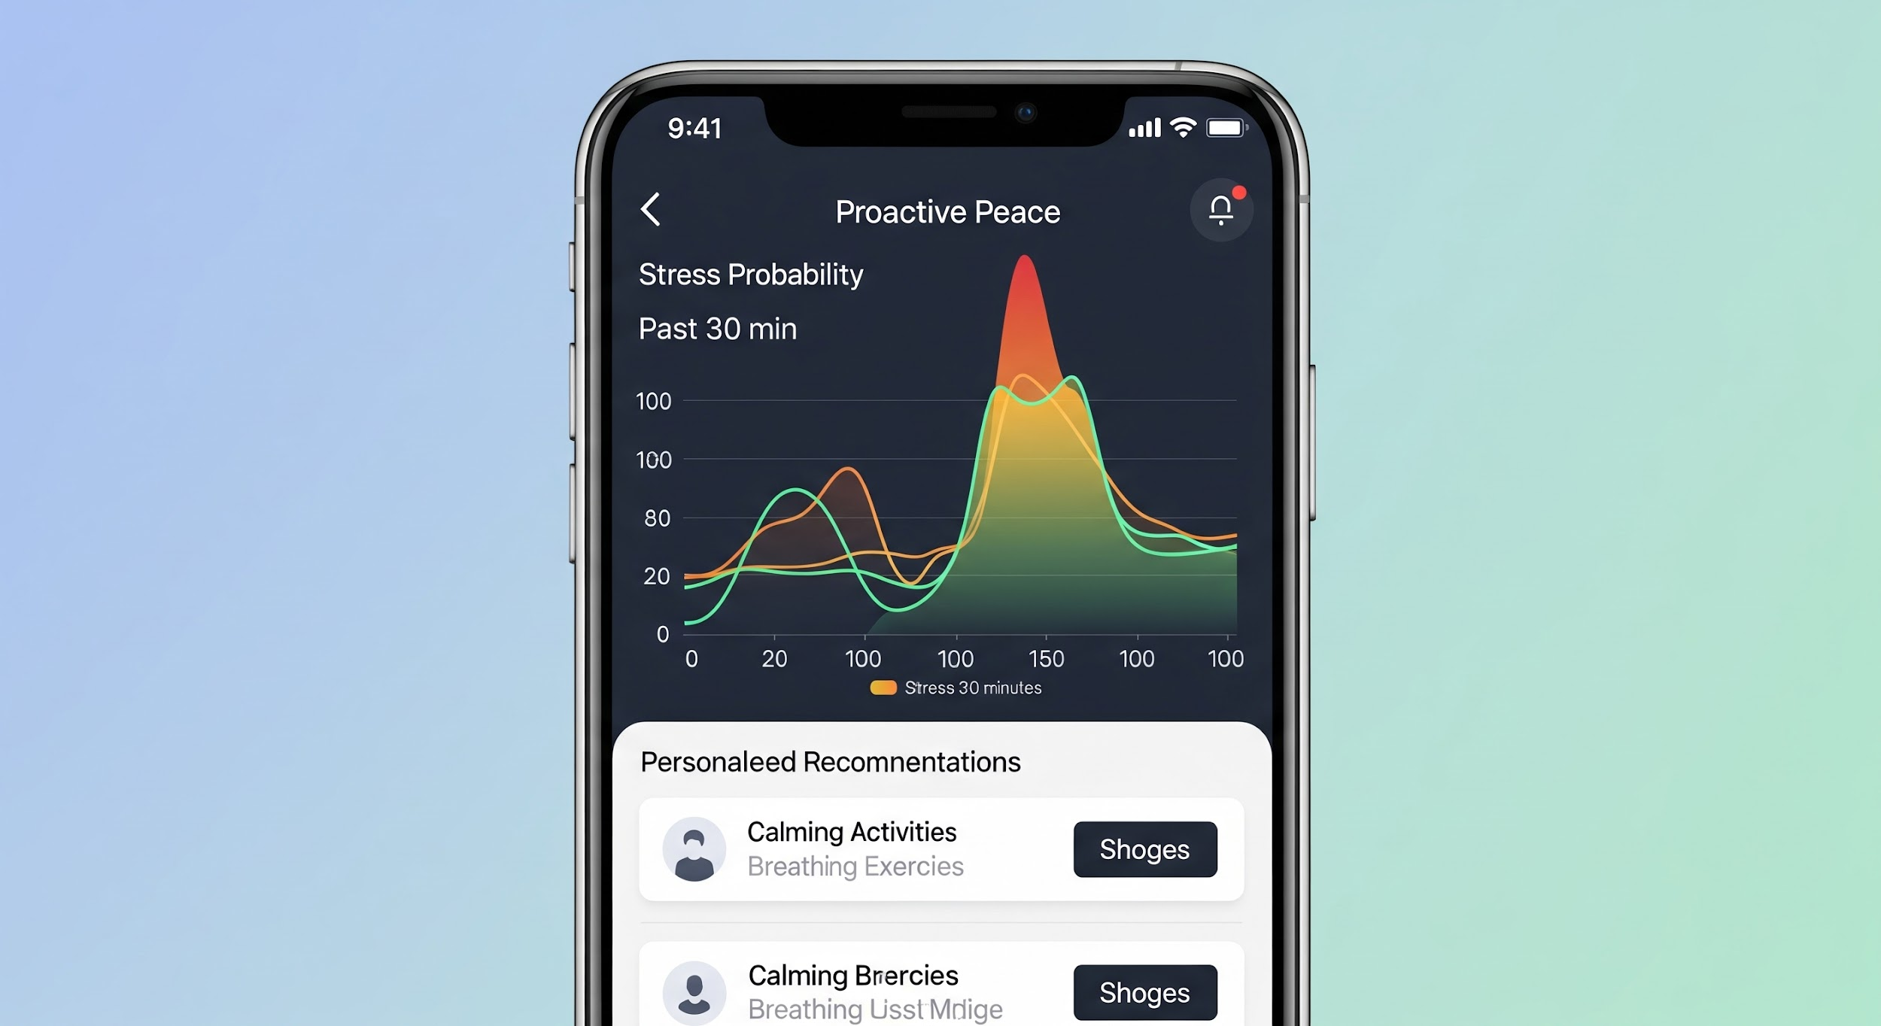
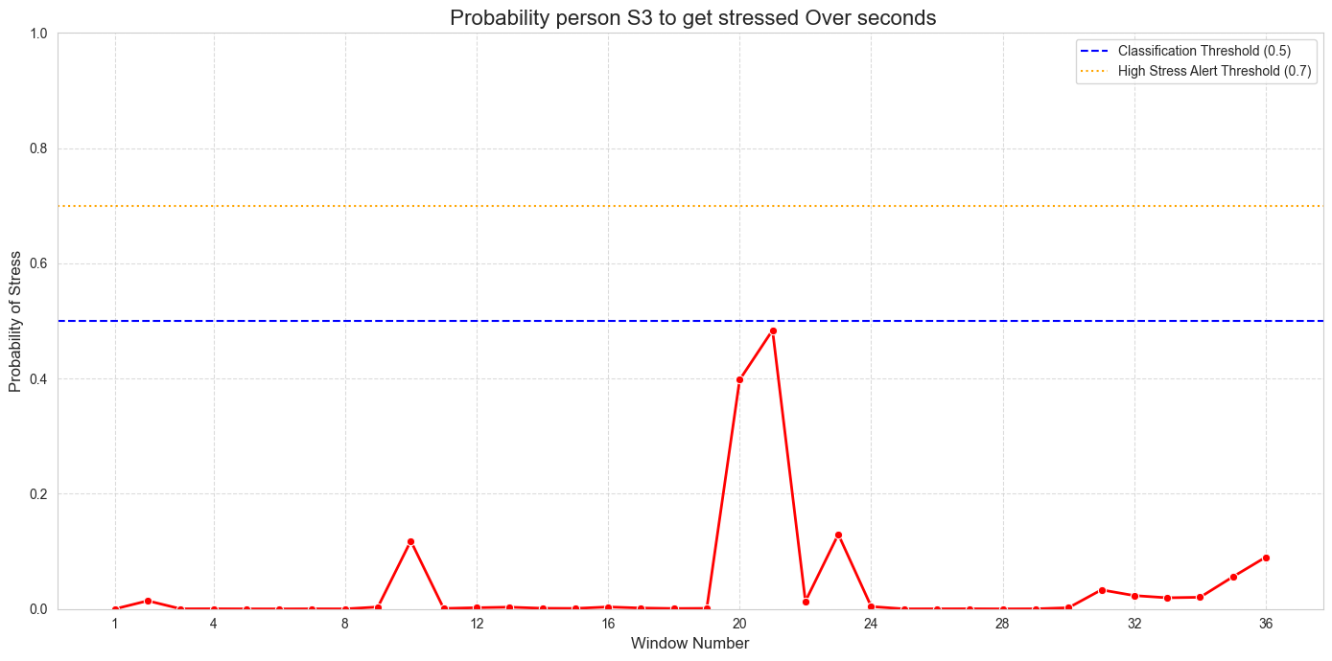
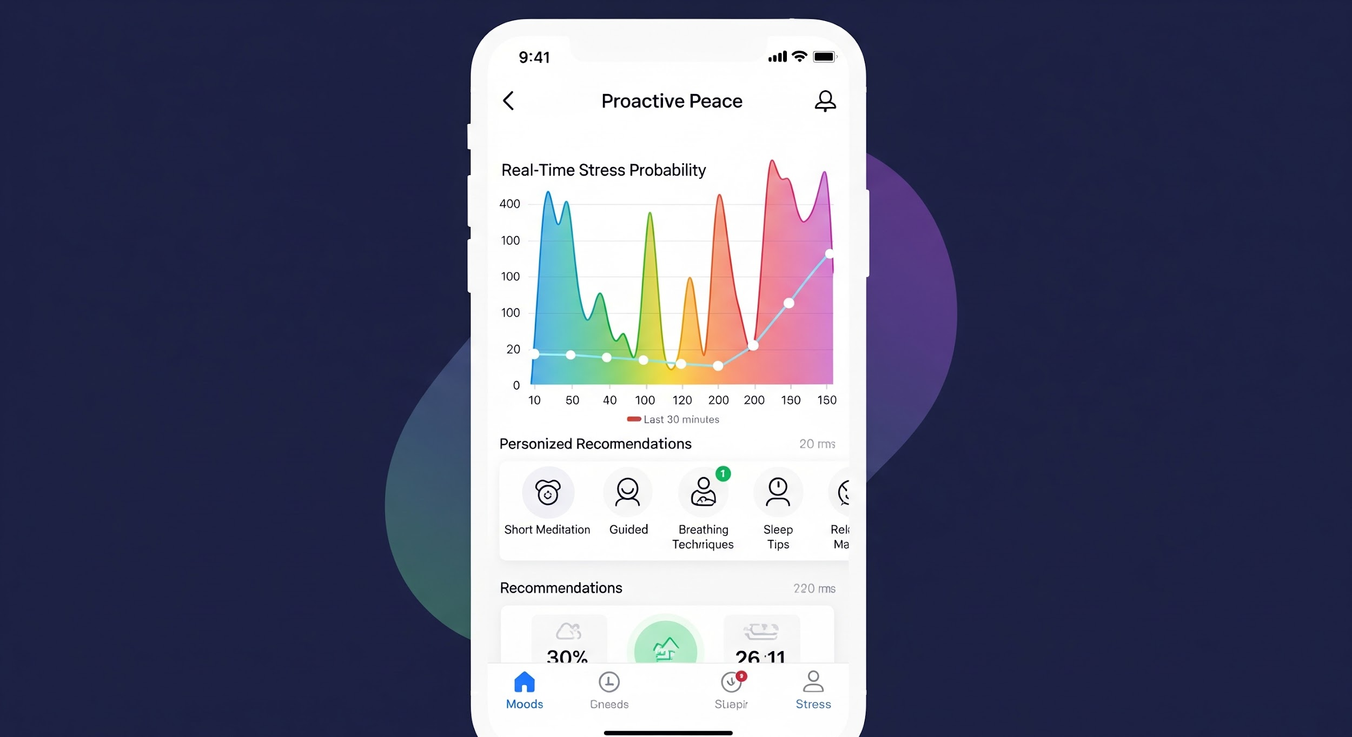
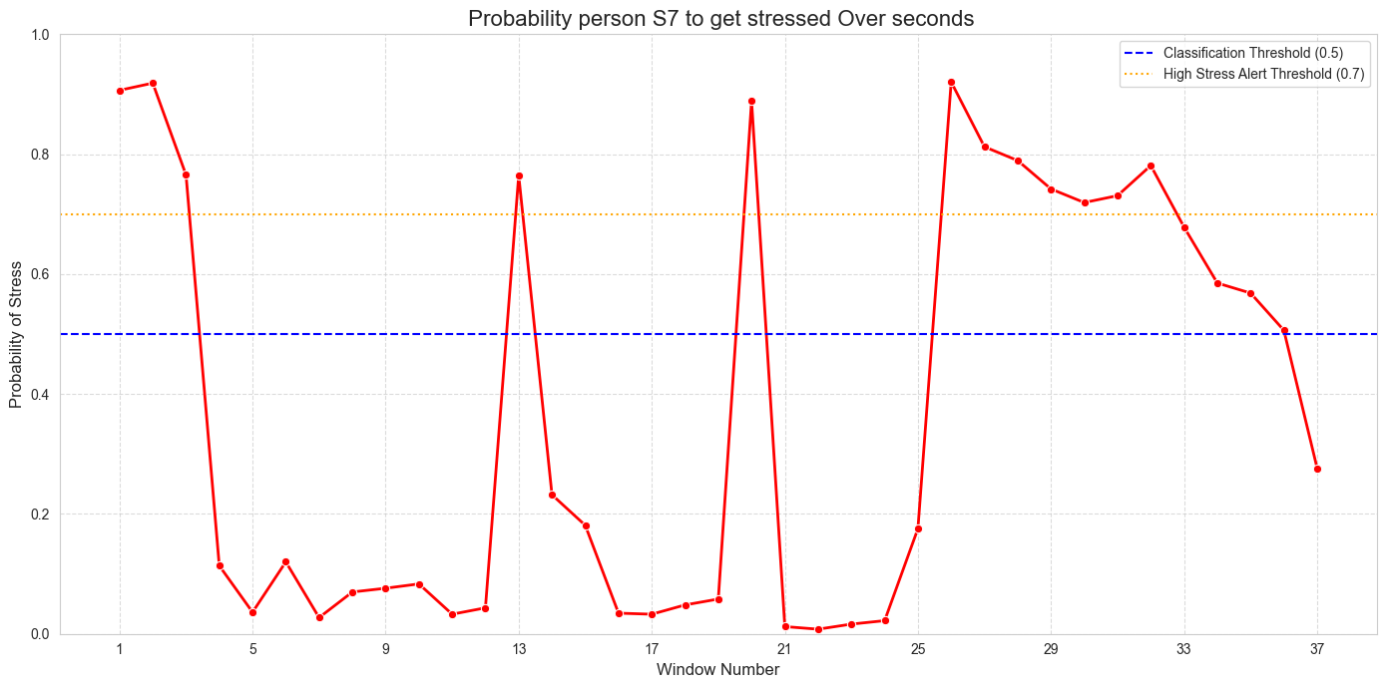
ML Models

Slide 16





High level architecture
Sensor data
streaming ingestion
Predicting results
Revise stress trend
Stress Alerts / recommendation
End user notification
Artifact Registry
Object Storage

Slide 17
Challenges
Data Preprocessing Complexity: The raw WESAD sensor data required extensive preprocessingFeature Engineering: Deriving relevant features from the time-series data, specifically using Fast Fourier Transform (FFT) and averaging over subwindows, was a complicated step
Class Imbalance: Stress instances (the positive class) are often less frequent than non-stress instances, which can bias models towards the majority class
Model Generalization (Subject-Independent Evaluation): Evaluating model performance using Leave-One-Subject-Out (LOSO) cross-validation results in lower, but more realistic, performance metrics compared to subject-dependent validation.
Model Input Shape Management: Different model types (CNN vs. tree-based models like XGBoost/LightGBM) require distinct input data shapes and types. Ensuring correct data transformation at each stage was a recurring challenge.
Model Performance Variability Across Subjects: Even with LOSO, individual subject performance varied significantly.
Notes:
Data Preprocessing Complexity: The raw WESAD sensor data required extensive preprocessing, including upsampling, noise reduction, and careful windowing, to extract meaningful features for the models. This multi-step pipeline is crucial but adds complexity.
Feature Engineering: Deriving relevant features from the time-series data, specifically using Fast Fourier Transform (FFT) and averaging over subwindows, was a critical step to convert continuous signals into a tabular format suitable for machine learning models. The choice of features significantly impacts model performance.
Class Imbalance: Stress instances (the positive class) are often less frequent than non-stress instances, which can bias models towards the majority class. This was addressed using class_weight (for CNN) or scale_pos_weight/is_unbalance (for XGBoost/LightGBM) during training.
Model Generalization (Subject-Independent Evaluation): Evaluating model performance using Leave-One-Subject-Out (LOSO) cross-validation was essential to assess how well models generalize to new, unseen individuals. This often results in lower, but more realistic, performance metrics compared to subject-dependent validation.
Model Input Shape Management: Different model types (CNN vs. tree-based models like XGBoost/LightGBM) require distinct input data shapes and types (e.g., 4D tensors for CNNs vs. 2D flattened arrays for tree models). Ensuring correct data transformation at each stage was a recurring challenge.
Model Performance Variability Across Subjects: Even with LOSO, individual subject performance varied significantly. For example, some subjects like S4, S8, and S13 showed very high F1-scores (1.0000) with LightGBM, while others like S3 (0.5263) and S17 (0.1333) showed much lower F1-scores. This highlights individual physiological differences and the variability of stress response.

Slide 18
Future Work
01
02
03
04
Gather & Enrich Data
Enhance
Productionalize
Discover
Embed
Capture insights, identify key challenges, and define the ideal outcome of our collaboration
Acquire Deeper Datasets: Integrate specialized data
Increase Real-Time Data (Individual data entries, environmental factors e.g. AQI, Temperature)
Develop Actionable Recommendations: Move from simply showing a "risk score" to providing a prioritized list of the topmost impactful, personalized actions a user can take.
Move beyond chronic diseases
Build a robust, secure, and scalable Interface to support staff in remote locations.
Build a simple, secure API that allows hospitals, schools, transport companies, insurance providers to easily integrate the Proactive Peace's insights into their existing systems with minimal friction.
Notes:
Imagine a healthcare system where fewer errors occur due to stress. A transportation network with safer drivers. Classrooms where teachers are consistently at their best. Proactive peace makes this future a reality.

Slide 19
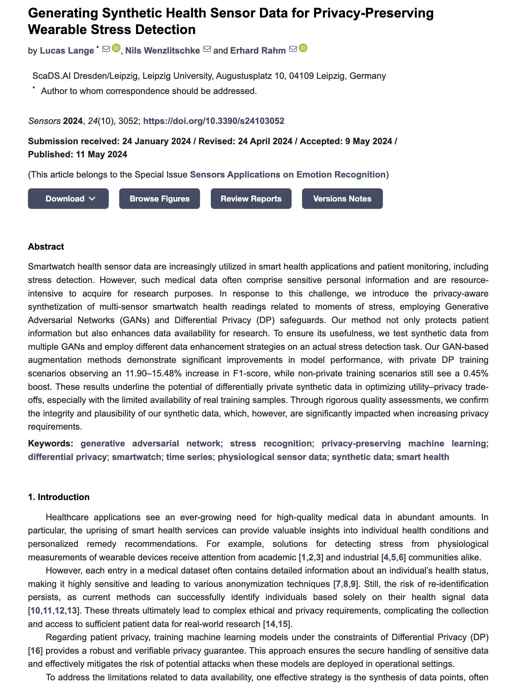
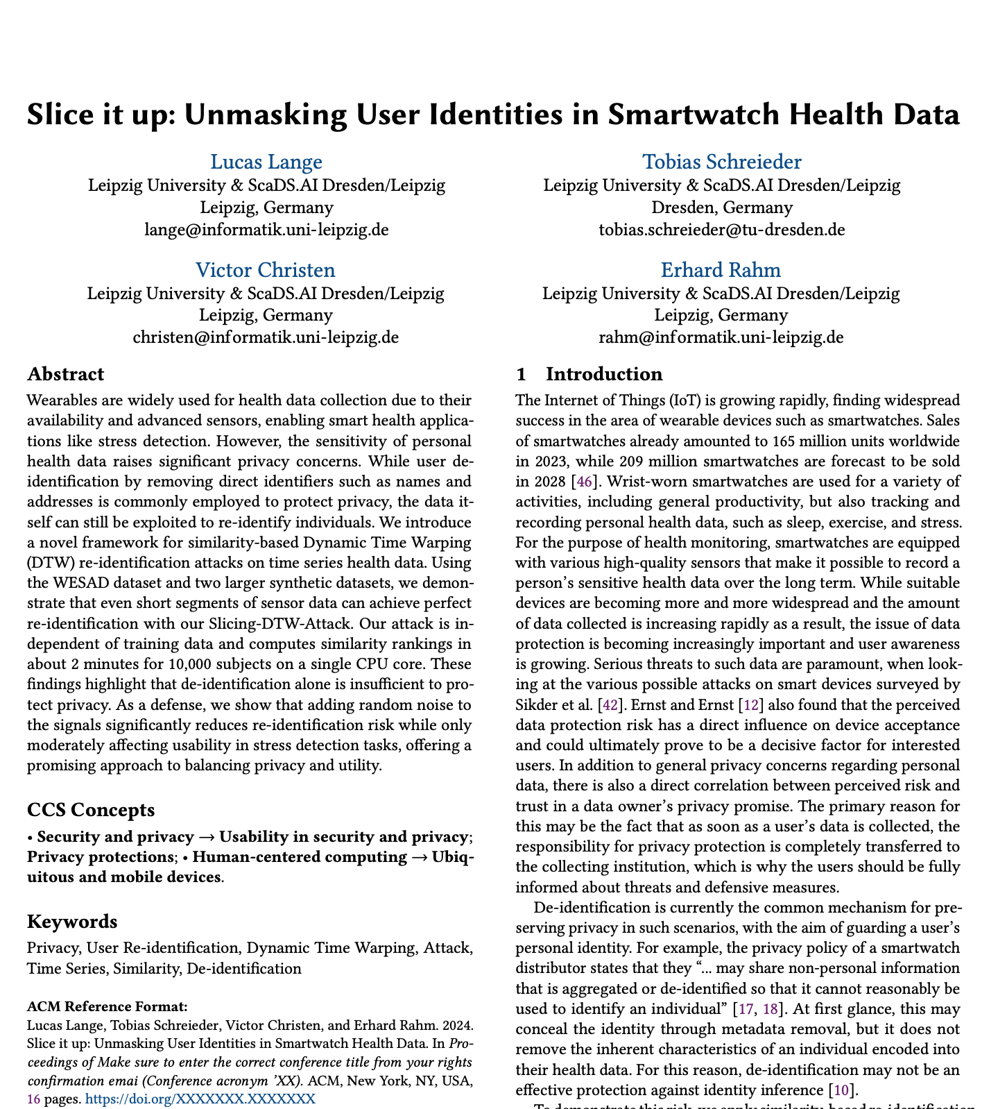
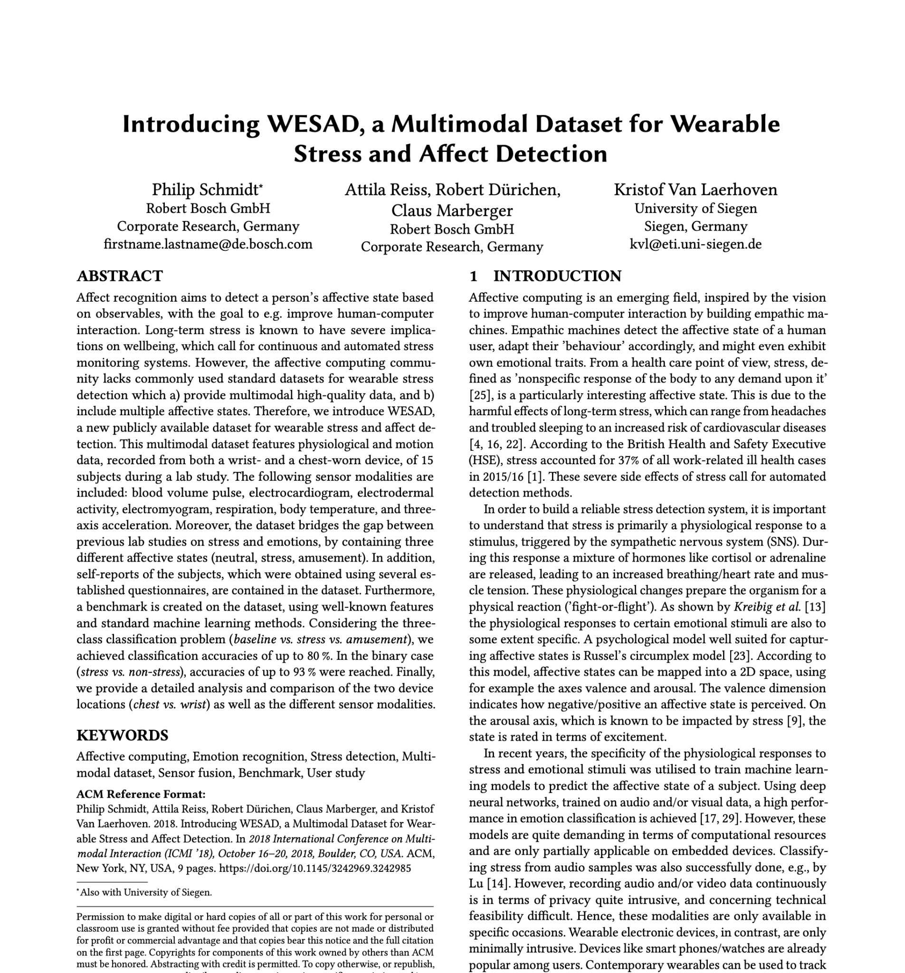
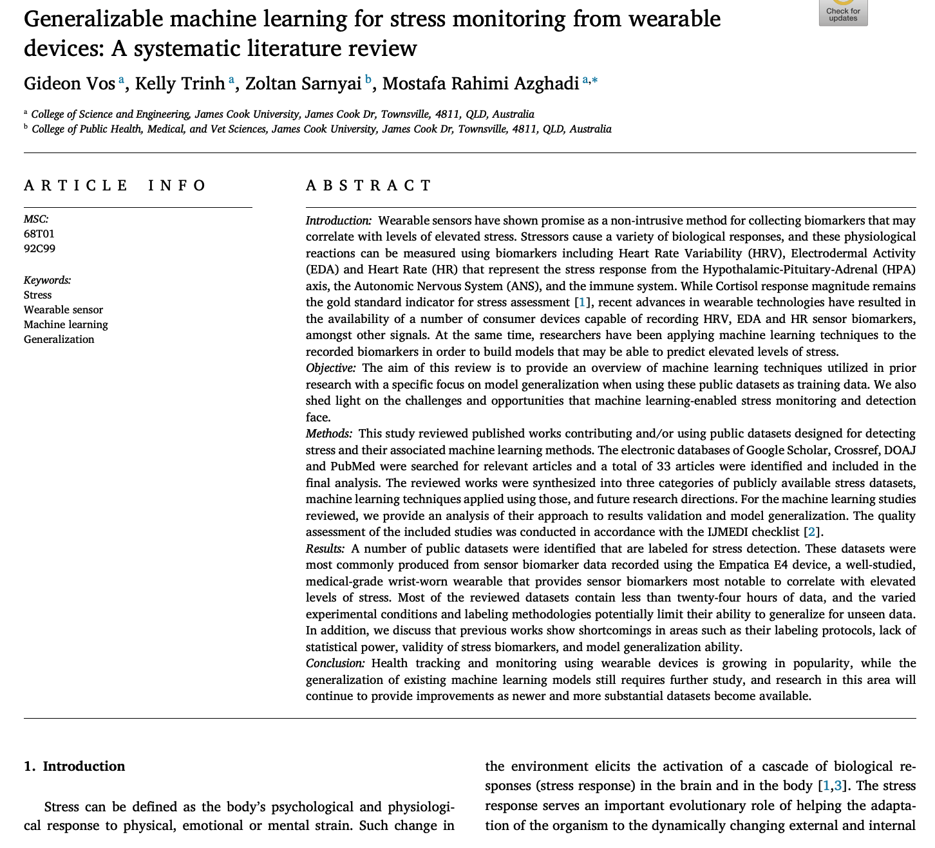
References
Model generalization ability
Lack of statistical power, labeling methodologies, validity of stress biomarkers
Measurement accuracy
Most of the studies datasets contain less than twenty-four hours of data
Notes:
Dataset: https://zenodo.org/records/14734046
machine learning for stress monitoring from wearable devices: https://www.sciencedirect.com/science/article/pii/S1386505623000436
Slice it up: Unmasking User Identities in Smartwatch Health Data https://arxiv.org/pdf/2308.08310

Slide 20
Acronyms
Stressors cause a variety of biological responses, and these physiological reactions can be measured using biomarkers including
Heart Rate Variability (HRV)
Electrodermal Activity (EDA)
Heart Rate (HR)
Hypothalamic-Pituitary-Adrenal (HPA) axis
Autonomic Nervous System (ANS)
Electrocardiogram (ECG)
Electroencephalography (EEG)
Photoplethysmography (PPG)
electrocardiogram (ECG)
respiration (RESP)
3-axis accelerometer (ACC)
blood volume pulse (BVP),
skin temperature (TEMP),
electromyogram (EMG)
Notes:
Dataset: https://zenodo.org/records/14734046
machine learning for stress monitoring from wearable devices: https://www.sciencedirect.com/science/article/pii/S1386505623000436
Slice it up: Unmasking User Identities in Smartwatch Health Data https://arxiv.org/pdf/2308.08310

Slide 21
That’s a wrap
Thank You

